Slide 1
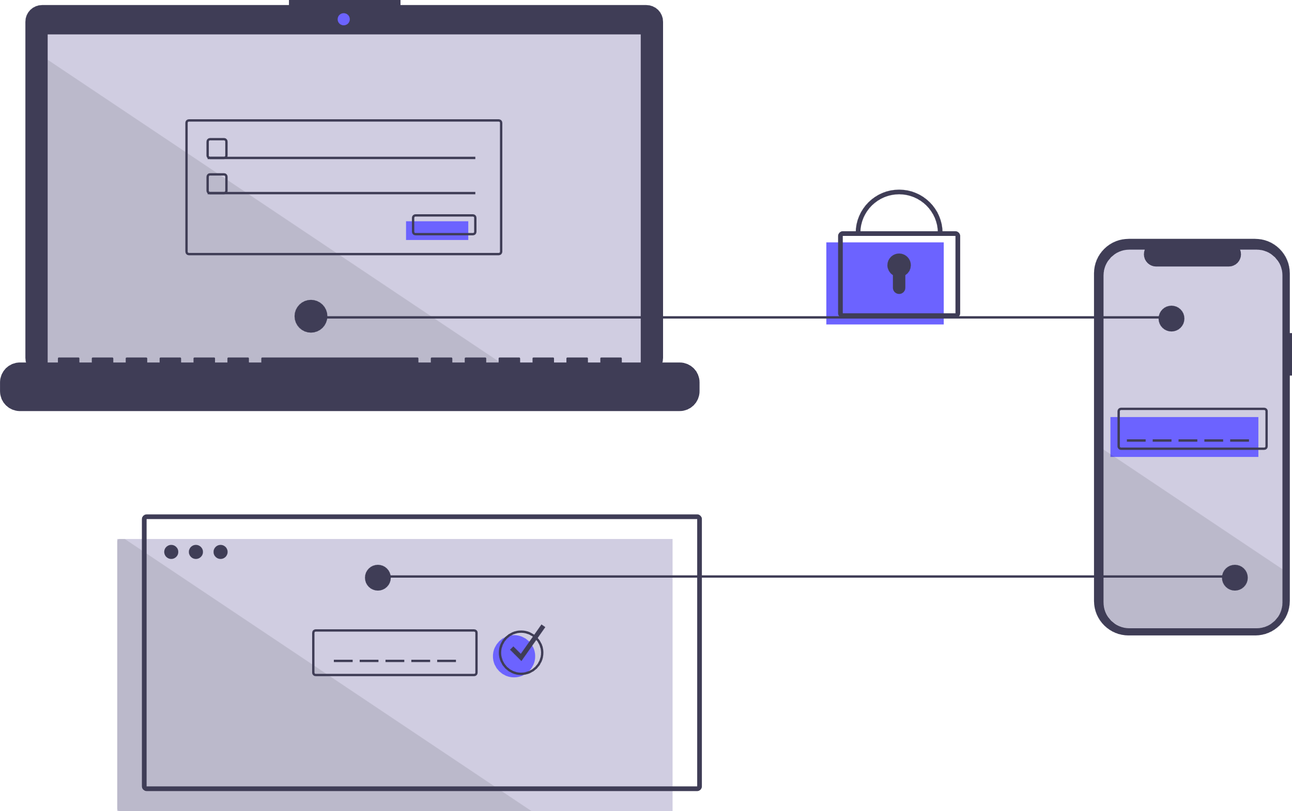
Design Smart Tv App Layout
Fundamental Towards UX
Guided By :
Gunjan Kadu.
Sagar Shimpi.
Presented By :
Virendra Kadam.
Abhinay Khalatkar.
Ankush Gangal.

Slide 2
Task Allocation
Sign-up Page –Ankush
Home Page - Abhinay
Analytics page ,Profile selection - Virendra

Slide 3
Content
Introduction
User Research
User Personas
Questionnaires
Key Findings
Requirement Analysis
User Flow
Lofi Prototype
Hifi Prototype
Summery

Slide 4
Introduction
In an era of rapid technological advancements, smart devices have become an integral part of our daily lives, revolutionizing the way we interact with technology. Among these innovations, smart televisions have emerged as a key player in the home entertainment landscape, offering users an immersive and versatile viewing experience. A crucial element in enhancing the usability and appeal of these devices is the user interface (UI) and user experience (UX) design, which govern how users interact with the TV and its functionalities.
This report focuses on the fundamental aspects of UI/UX design for a smart TV, aiming to create an intuitive and engaging user interface that caters to the diverse needs and preferences of viewers. By incorporating thoughtful design principles, we strive to optimize user interactions, simplify navigation, and elevate the overall user experience.

Slide 5
User Research
Here we are showing our findings on what is expected of UI of a Smart TV By engaging with a diverse group of participants, we aimed to gain insights into their behaviors, preferences, and pain points related to smart TV usage. The objective was to create a user-centered design that enhances the overall viewing experience and meets the needs of our target audience.
Our research included a diverse sample of participants, ensuring representation across different age groups, occupations, and technological backgrounds. The participants consisted of both tech-savvy individuals and casual users, allowing us to capture a wide range of perspectives.

Slide 6
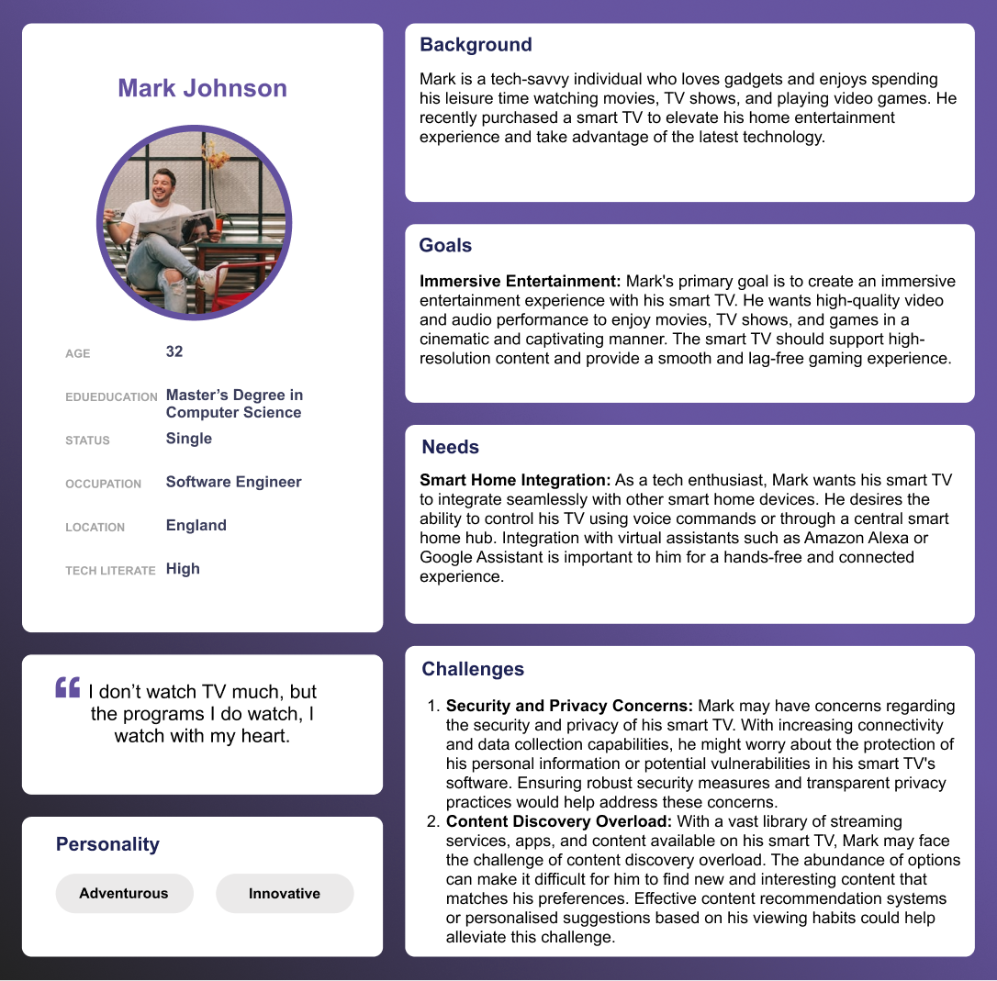
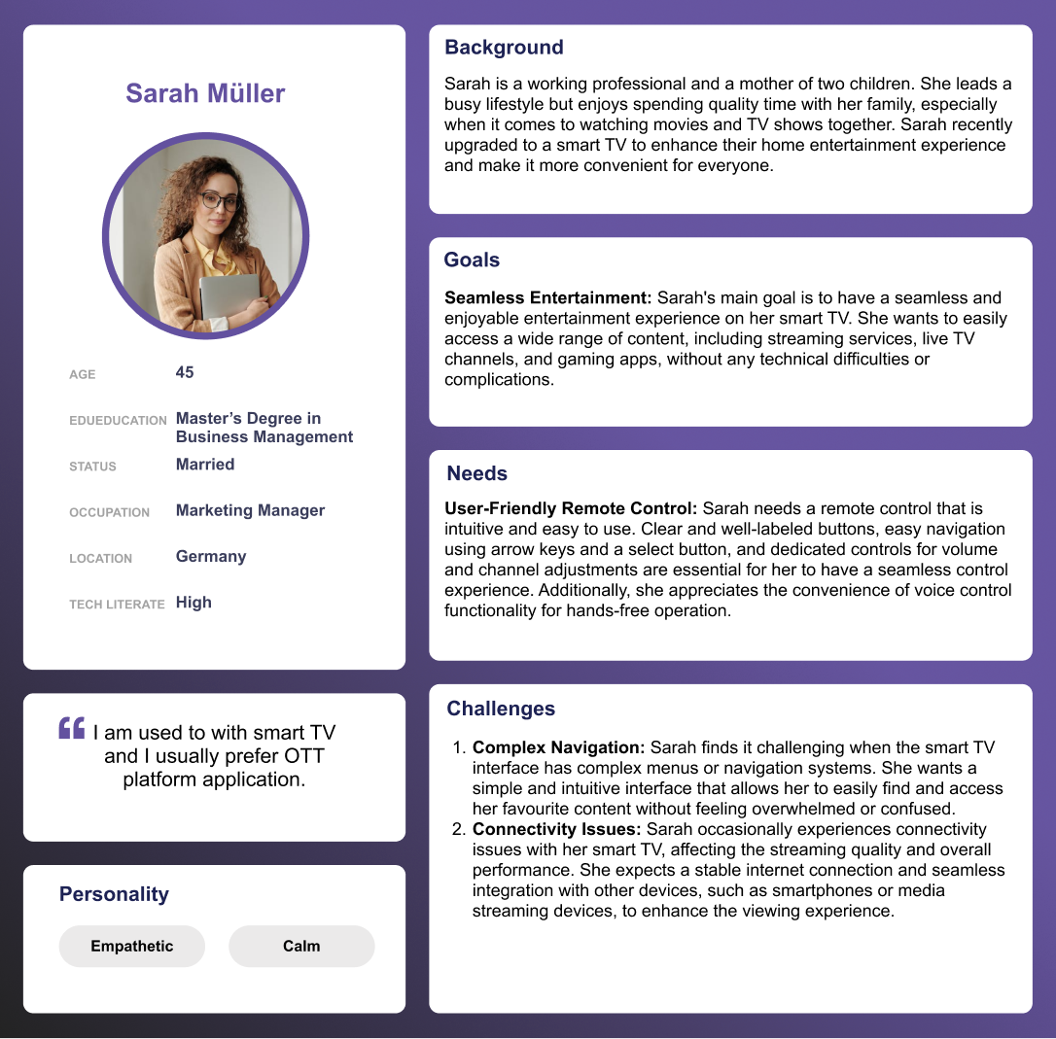
User Persona

Slide 7
Questions that we asked users
How do you currently discover and access content on your smart TV?
What customization options would you like to have for the home screen and app placements?
How do you prefer to interact with your smart TV? Do you use voice control, traditional remote control, or both?
What visual elements do you find appealing and easy to understand in a user interface?
How important is the speed and responsiveness of the smart TV interface to you?
Do you use other smart devices alongside your smart TV? How do you expect them to integrate and work together?
Do you engage in social media or content sharing activities related to your TV viewing experiences?
How important is data security and privacy to you when using a smart TV?

Slide 8
Key findings(Participants desired )
an intuitive interface for simplified content discovery
emphasized customization options
favored voice control.
and appreciated visually appealing designs with accessibility considerations.
UI which can also be used on other devices.
UI which can affect energy consumption
Where all content streaming platforms can be unified
Should be personalized for individual

Slide 9
Requirenment Analysis(based on key findings)
Intuitive content discovery across sources with personalized recommendations and universal search.
Customizable home screen, profiles, and app placements for personalized user experiences.
Balanced integration of voice control and traditional remote control functionality.
Visually appealing design with accessibility features.
Smooth navigation, fast performance, and seamless multi-device integration.
Unified access with security
Unique experience for all users

Slide 10
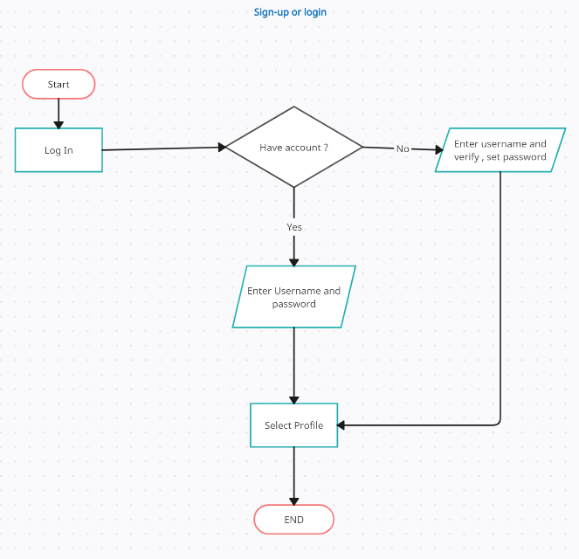
Userflow – Login/Sign-Up
User-Story 1)-As a user, I want to be able to login or sign up to access personalized features and secure my account.

Slide 11
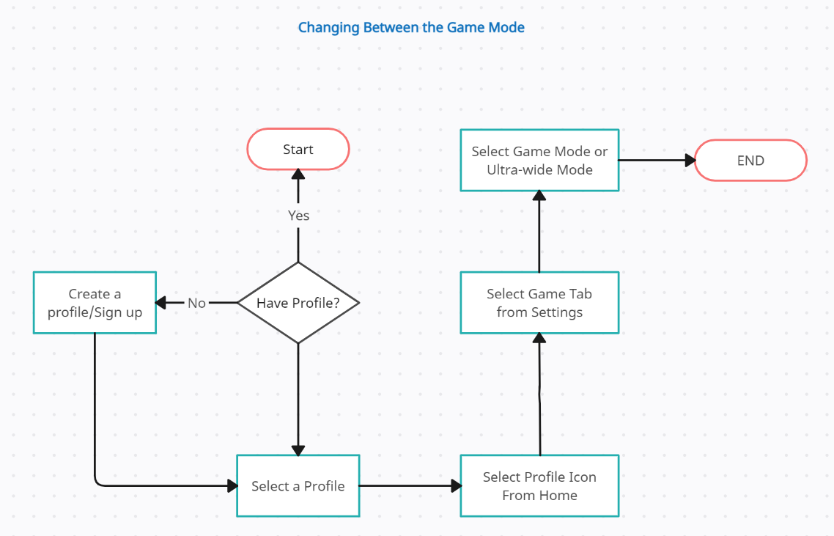
Userflow – Changing Game Mode
User-Story 2)-As a user, I want to change between the given game mode as current one is not very immersive.

Slide 12
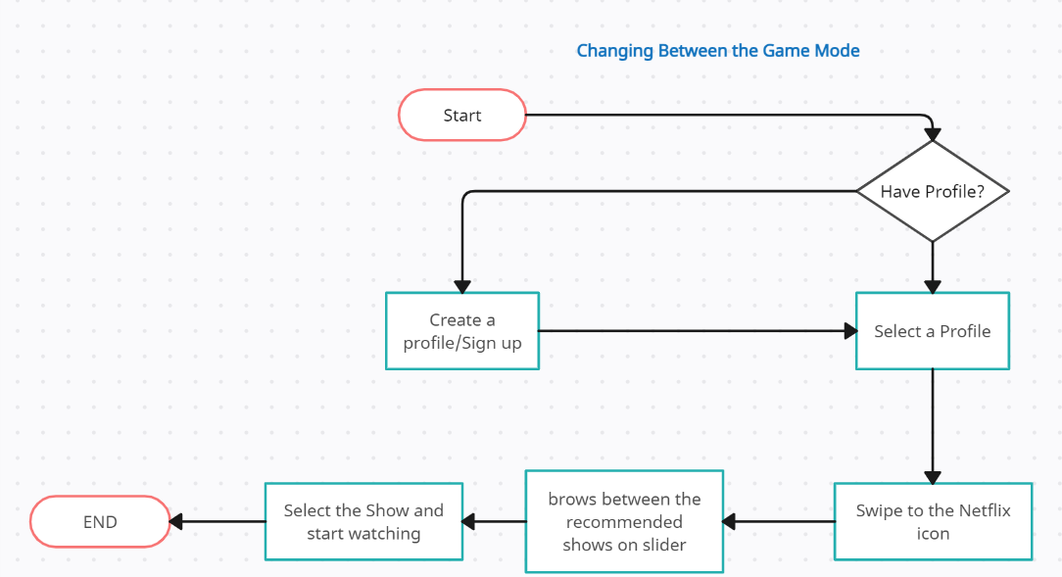
Userflow – Watch a Recommended Show
User-Story 3)-As a user, I want to Watch a show Recommended on Netflix without opening the app.

Slide 13
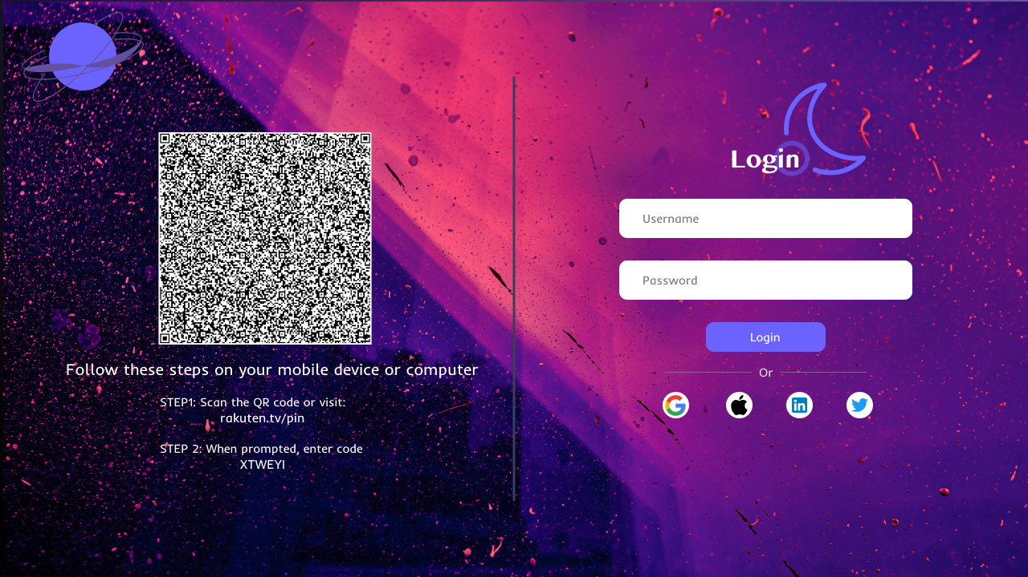
SIGN-UP
It's important to note that privacy and data security considerations should be taken into account when implementing sign-up features in Smart TVs. User consent and clear privacy policies should be provided, and data should be handled in accordance with relevant regulations and best practices to ensure user trust and security.

Slide 14
Requirements Analysis
Varying demographics of different ages-should be simple
Need of a UI suitable for all users
Content should be easily accessible

Slide 15
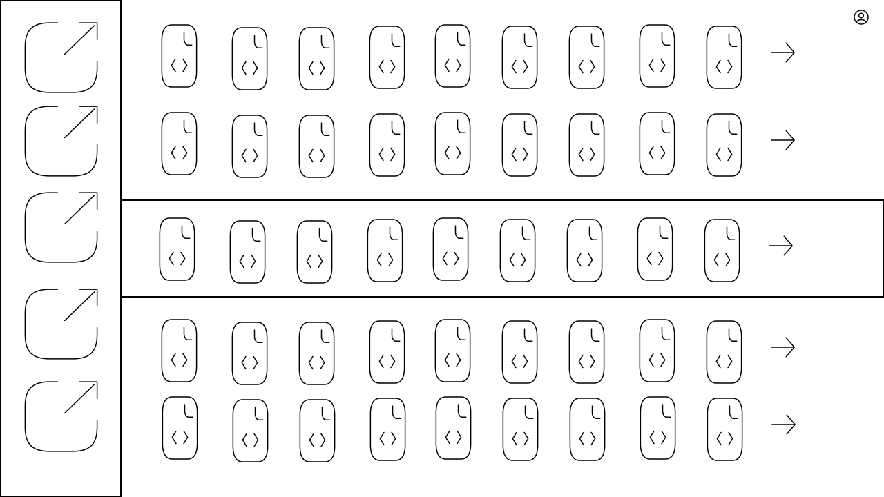
TV HOME – Lo-Fi Prototype

Slide 16
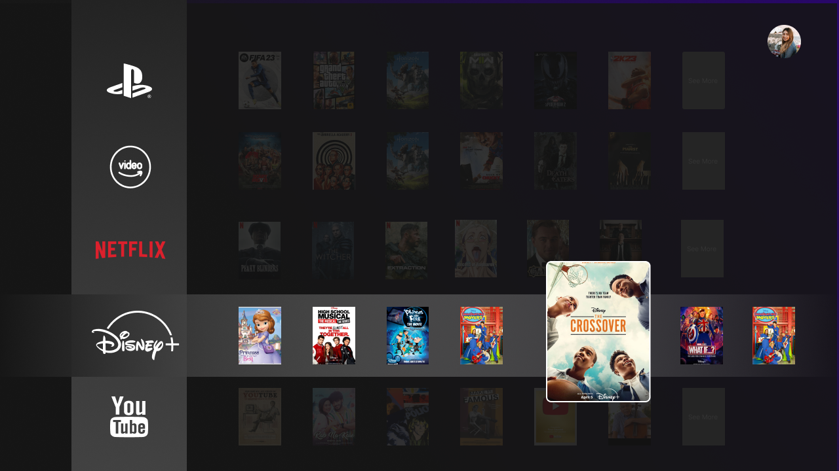
TV HOME – Hi-Fi Prototype
Accessibility to all apps
Trending visible shows
Can go through all content without opening the app
Color
Customization
Responsiveness
Notes:
1,2,3- Law of similer region
Each app shows only 4-7 elemets – millers law
4-Reson for picking this color was to decrease strain on eyes in night time and also as per our analysis we found that most of tv screen now a days turns on pixel during redering dark elements ,so it also good in order to save power
-profile icon and night mode toggler –some of the dialog principle self descrptivness and controllablity

Slide 17
Requirements Analysis
Profile Customization
Settings Navigation
Content Display
Smooth Scrolling

Slide 18
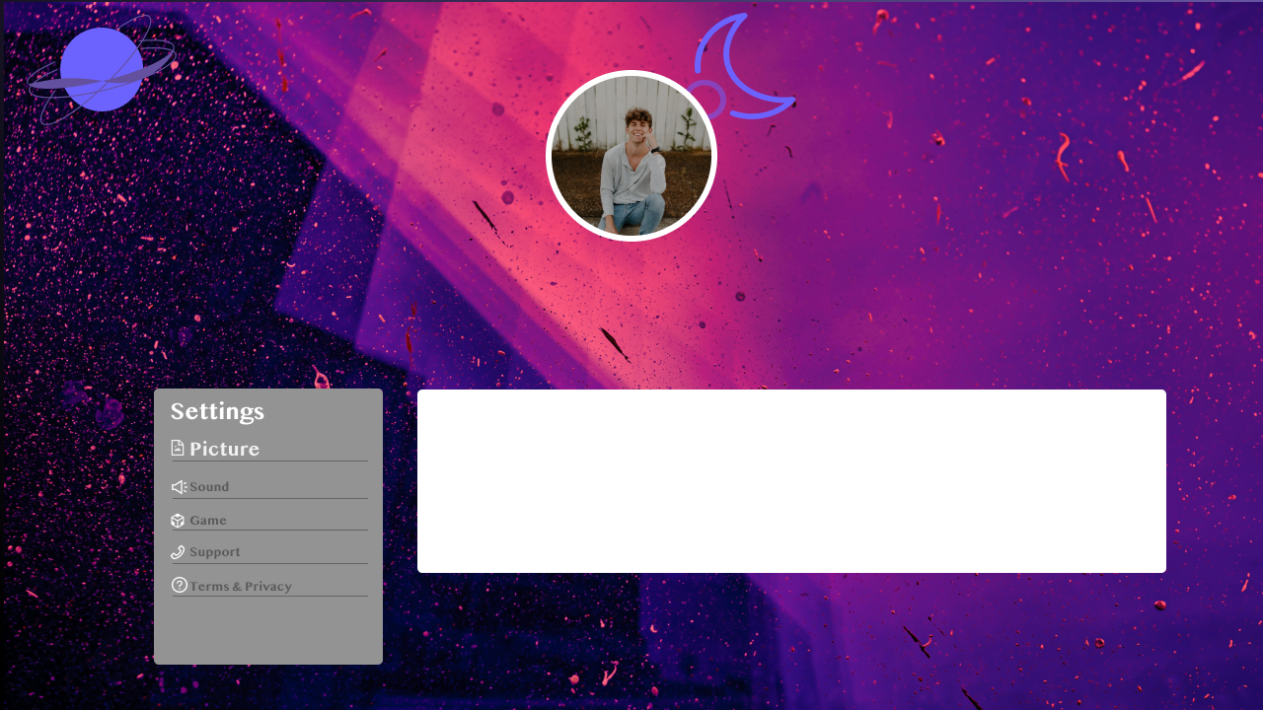
Profile Screen
Purpose
Content
Responsive
Notes:
The main purpose of this code is to create a profile page where users can customize their profiles, adjust various settings, and view graphs related to their TV usage.
The profile page consists of a profile card that displays the user's details, such as their name, ranking, age, location, and email. It also includes a settings column with different options like picture, sound, game, general settings, support, and privacy. Users can select these options to customize their preferences.
One important aspect of this code is the inclusion of responsive design principles, which ensure that the profile page is accessible and looks good on different devices and screen sizes. The layout adapts based on the screen size, ensuring a consistent and user-friendly experience across various devices.

Slide 19
Analysis of UI/UX Laws
Law of Proximity
Law of Similarity
Law of Fitts
Law of Visibility
Law of Consistency

Slide 20
Summery
The code successfully address to UI/UX laws and requirements by creating an intuitive and user-friendly interface for the profile component and settings section in the smart TV layout. The design choices, such as proximity, similarity, Fitts' law, visibility, and consistency, contribute to a seamless user experience. Additionally, the code fulfills the necessary functionalities, including profile customization, settings navigation, content display, and smooth scrolling, enhancing the overall usability and user satisfaction.

Slide 21
Thank You

